Slide 1
Problem statement
The Big Mountain Resort is looking for a new business strategy. In order to capitalize on additional resources that were added to their resort this season, management is looking for guidance to increase profits either by cutting the operating costs without undermining the current ticket price or will support an even higher ticket price.

Slide 2


Recommendations
The model predicted the ticket price of the Big Mountain Resort to be $95.87 based on the key features. Big Mountain Resort can increase ticket price between $90 and $100. And still be competitive with the other skiing resorts nationwide.
Big Mountain Resort can optimize their operations to cut down their operating expenses without negative impact to their ticket prices.

Slide 3
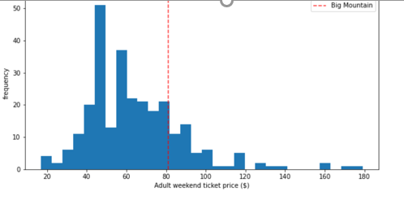
Analysis results
The current weekend price of the Big Mountain Resort is $81.00.
The frequency plot shows that the ticket prices of Big Mountain Resort are lower than some of the other resorts nationwide with less facilities.

Slide 4
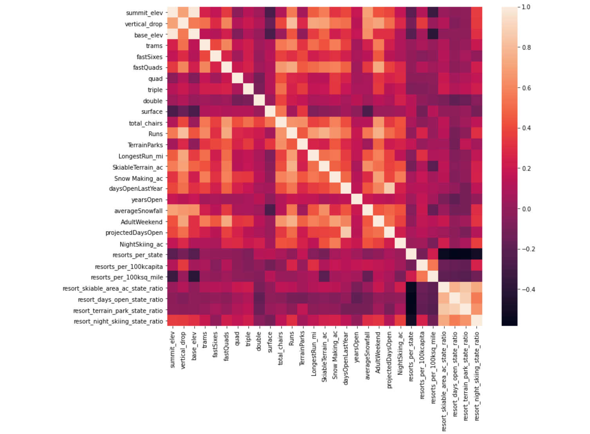
Analysis results
To optimize their operations, the heat map was used to find the ski resort features that are most correlated to their ticket prices.
Note that we used the nationwide ski resort data for this comparison and not limited to the state of Montana.

Slide 5
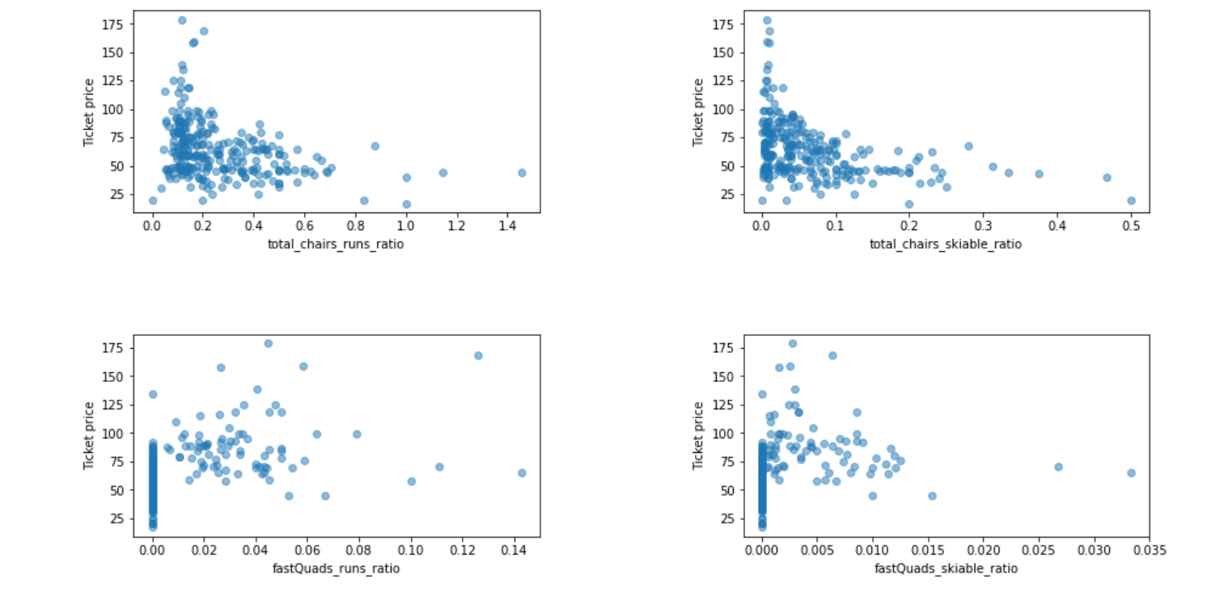
Analysis results
The scatter plots highlight the 4 key features that impacted ticket prices the most:
1. Fast Quads,
2. Runs,
3. Snow-making
4. Vertical Drop.
Based on these correlations and key features, modeling was used to estimate the ticket price for Big Mountain Resort.

Slide 6
Modeling results
The model predicted the ticket price of the Big Mountain Resort to be $95.87 based on the key features.
Although, Big Mountain Resort can increase ticket price to a maximum of $106.40 and still be competitive with the other skiing resorts nationwide.
In comparison, the current weekend price of the resort is only $81.00.
Big Mountain’s vertical drop, snow making data, total chairs, no. of runs, area of skiable terrain area and no. of fast quad are relatively high among all resorts country-wide.
Modeling results provide different scenarios to reduce the operating costs, for example, the resort can close their least unpopular runs and their related facilities.

Slide 7
Conclusions
Big Mountain Resort can increase ticket price to a maximum of $100.
Big Mountain Resort can optimize their operations to cut down their operating expenses.

Slide 8
Thank You
Neha Choudhary
14th Jan 2021

